Slide 1
EXPERIMENT 19
MAKE COMPUTER LAB IN CISCO PACKET TRACKER
ALGORITHM :
Step 1: take 14 pc’s and one switch(2960-24) and take one server pt
Step 2: connect the Server PT with switch(2960-24)
Step 3: And then connect the switch with pc’s
Step 4: one by one connect all the pc’s
Step 5: Give IP address for each one of the pc’s
Step 6:After that simulate the network

Slide 2
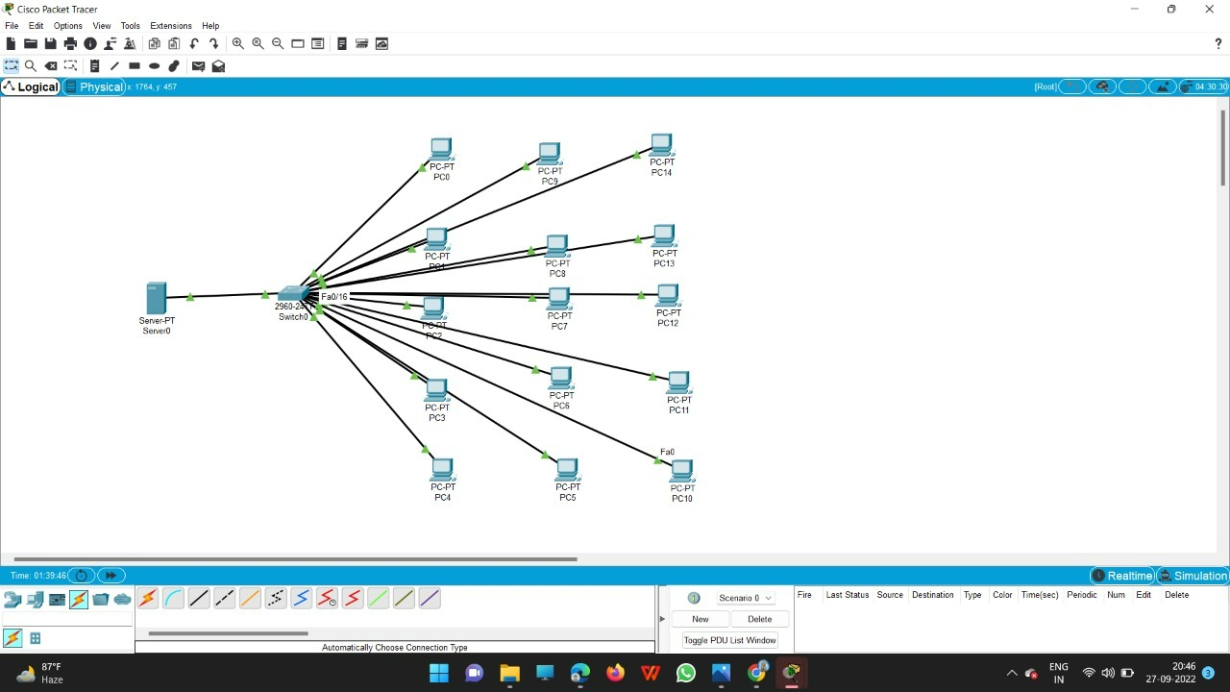
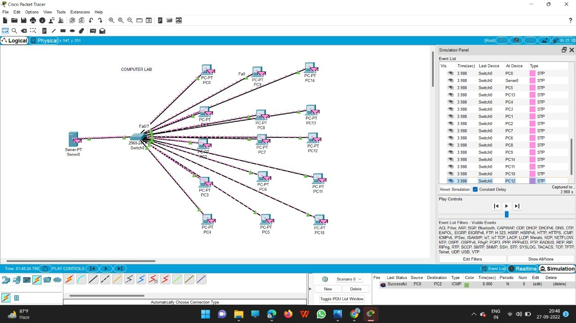

Slide 3
